Slide 1

BOTSv3 Investigation Findings and Reflections
By Samuel Stevens

Slide 2
Key Findings from BOTSv3
4 IAM Users within the dataset: Bstoll, Btun, splunk_access, and Mkraeus
AWS API calls were made without Multi-Factor Authentication(MFA).
An S3 Bucket called frothlywebcode was misconfigured and made public by user Bstoll.
During its exposure, a .txt file was successfully uploaded to the bucket named “OPEN_BUCKET_PLEASE_FIX.txt”

Slide 3
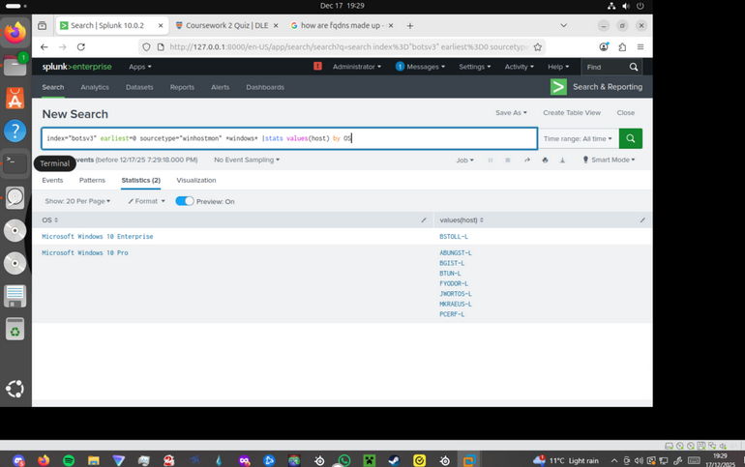
Explanation of Key SPL Queries: OS’s used by hosts

Slide 4
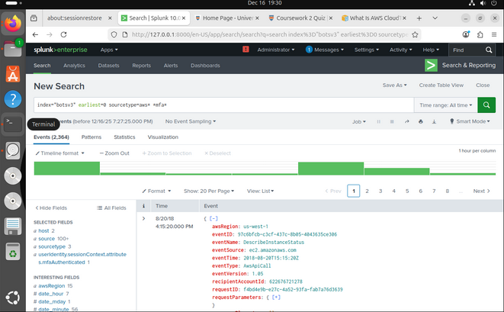
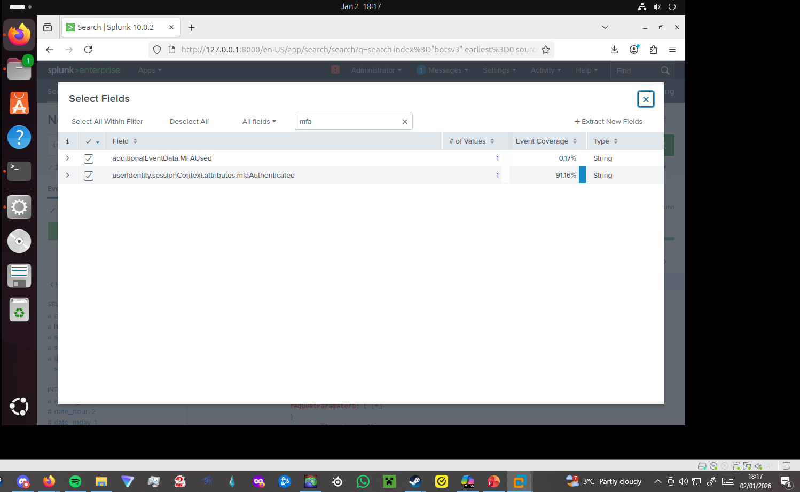
Key Queries Continued: MFA Keyword Search

Slide 5
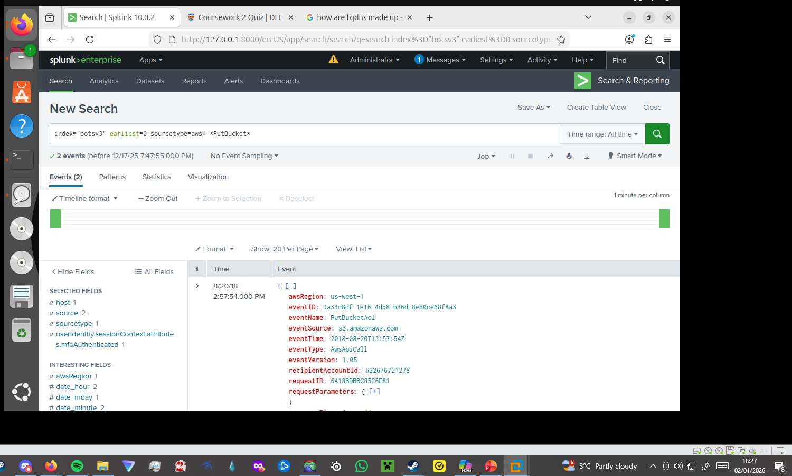
Key Queries: Finding bucket misconfiguration

Slide 6
Reflection on SOC operations and incident response and lessons learned.
Lesson learned: The impact that comprehensive logging and security visibility can have on an investigation.
Effective SIEM tool usage makes detecting and responding to suspicious or malicious behaviour significantly easier and quicker.

Slide 7
Thank you for listening
I am more than happy to answer questions either in person or via email at: samuel.stevens-10@students.plymouth.ac.uk

